Slide 1


Dan Pelino,
General Manager
IBM Global Public Sector

Slide 2


Slide 3
Dan Pelino,
General Manager
IBM Global Public Sector

Slide 4








Slide 5




The Smarter Planet is changing...
From 1/2 to 2/3
The world’s population living in
cities today and in 2050 ¹
2.2% versus 4.9%
2015 GDP growth in mature
economies versus GDP growth in emerging economies ²
40 million
The global shortage in the number of tertiary educated workers by 2020 ³
Up to 55%
The range of reported rates of youth unemployment around the world ⁴
200 per person
The estimated number of connectable devices in the world today ⁵
20 Quintillion bytes
The volume of data produced globally each day, every day⁶
Notes:
First photo:
Urban areas can be tremendously efficient. It is easier to provide water and sanitation to people living closer together, while access to health, education, and other social and cultural services is also much more readily available. However, as urban areas grow, the cost of meeting basic needs increases, as does the strain on the environment and natural resources [1 http://data.worldbank.org/topic/urban-development ]
But urbanization also raises concerns about whether cities can finance enormous amounts of infrastructure for millions of new citizens, adequately plan for land requirements, provide basic services— and do all of this in a way that strengthens social capital, preserves the integrity of the Earth’s ecosystems. While urban areas face urgent challenges from population growth and climate change to increasing global competitiveness, inequity, and resource constraints, the opportunity for technology to help address these challenges has also never been greater. [BUILDING SUSTAINABILITY IN AN URBANIZING WORLD: A Partnership Report, World Bank Group, July 2013]
[2] Goldman Sachs global investment research
Middle Photo:
[3] tbd
[4] http://data.worldbank.org/topic/urban-development , Spain’s National Statistics Institute as reported by BBC - http://www.bbc.com/news/business-21180371
Third photo:
[5] Cisco: https://www.google.co.in/url?sa=t&rct=j&q=&esrc=s&source=web&cd=1&cad=rja&uact=8&ved=0CB8QFjAA&url=http%3A%2F%2Fwww.cisco.com%2Fweb%2Fabout%2Fac79%2Fdocs%2Finnov%2FIoE_Economy.pdf&ei=Jn3TVObMJ4O2mAW1_oGgAQ&usg=AFQjCNHxC5yjQ88FcP_qT_V1_02CfJKuNA&bvm=bv.85142067,d.dGY
[6] Source: http://www-01.ibm.com/software/data/bigdata/
Everyday around 20 quintillion (10^18) bytes of data are produced
Disruptive Technologies, McKinsey Global Institute, May 2013

Slide 6

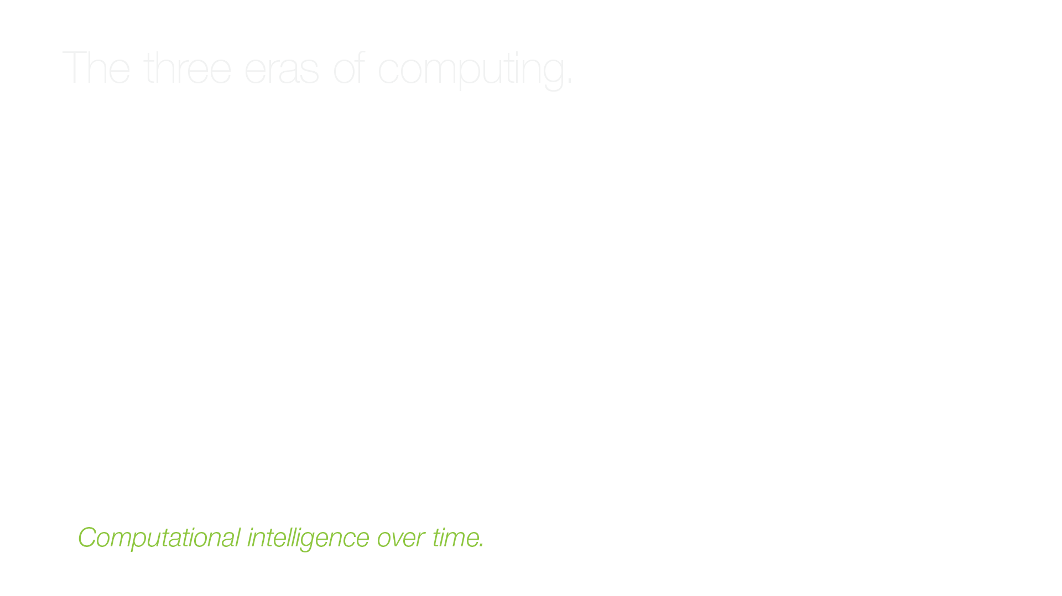
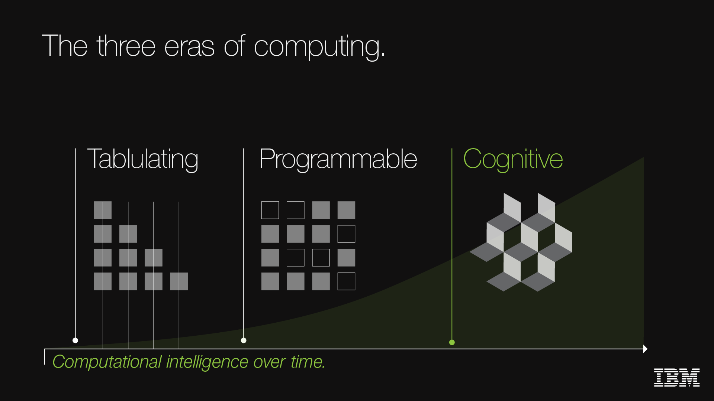

Slide 7







Slide 8

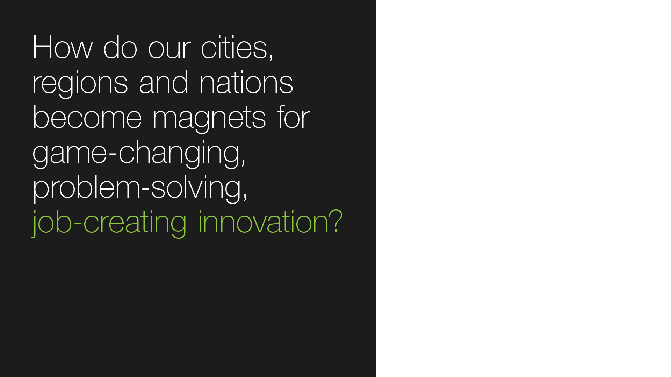
Notes:
Natural resources, citizen-based services, education

Slide 9




Slide 10

Health system performance
& optimization
The opportunity to create more sustainable healthcare systems
  Digital Hospital
  Enterprise Analytics-Business Performance
  IBM Integration Bus for Healthcare
  Privacy and Security for Hospitals
  Hospital Facilities Management
  Hospital Asset Management
  Counter Fraud for Healthcare
  Workforce, Recruitment and Talent Management
  Business Process Management
  Supply Chain Optimization
  Watson Customer Service
  Cloud Infrastructure
  MobileFirst
References:
The Ottawa Hospital
Notes:
References:
External:
http://www.ibm.com/mobilefirst/us/en/see-it-in-action/ottawa-hospital/
Several years ago, The Ottawa Hospital determined that its traditional workflow process could not keep pace with today's medical advances and increasingly complex health conditions.
In addressing this need for change, the hospital and IBM co-developed an innovative approach to Business Process Management (BPM) that puts mobility at the center of care. The team began its journey to transform the hospital into an mHealth operation, and set a new standard in healthcare with the eventual goal of becoming a top—10 percent performer in patient care and safety in North America.
CRDB: Ottawa Hospital: http://w3-01.ibm.com/sales/ssi/cgi-bin/ssialias?infotype=CR&subtype=NA&htmlfid=0CRDD-8SUPVP&appname=crmd
This Canadian hospital minimizes hospital stays and reduces wait times for emergency consultations when IBM Global Business Services helps it pioneer the use of IBM Cognos advanced analytics and IBM SPSS business process simulation to improve staffing levels, helping ensure that its patients receive world-class care.
Solution Details
By working with a Business Architect from IBM Global Services – Global Business Services, and an Information Architect, a Data Architect and an IBM WebSphere Message Broker Subject Matter Expert (SME) from IBM Global Services – Application Services, The Ottawa Hospital chose to implement a comprehensive Care Process Management (CPM) platform, based on IBM Business Process Manager V7.5.1, IBM Cognos Business Intelligence and IBM SPSS Software. This new platform will handle a range of process changes, but the initial implementation only focused on two. First, it will address the Emergency Department (ED) Consult Request, which manages the requests and responses from the Emergency Department and the Internal Department physicians. Its purpose for this department will be to help accelerate the admission and treatment of patients. Second, the platform will address the hospital’s Discharge Readiness Planning, which coordinates activities of the care team to ensure efficient and effective treatment of patients through admission to discharge. The solution integrates with existing hospital IT systems, and allows user interaction through Web browsers and mobile devices via the implementation of IBM Lotus Sametime software.
The process management solution addresses foundational problems encountered across multiple patient care processes by enabling the implementation of key capabilities, including:
- A closed-loop consult request capability, which delivers consult requests, including details of the request, providing immediate feedback to the requestor, tracks responses and supports escalation procedures and policies.
- A circle of care, which uses a graphical interface to help identify providers involved in a patient’s care and facilitates communication between providers.
- A multi-disciplinary activity plan, which coordinates activities of the care team, addressing activity assignments, progress, project completion and improves communication and collaboration across the care team.
Real Business Results
•Enables the hospital to capture its current baseline response times to consult requests, and model and implement procedural improvements to reach a goal of 15 minutes or less
•Provides 360-degree visibility to patient care and improves coordination of team activities to ensure efficient and effective treatment of the patient from admission through discharge
•Inadequate responses to consult requests can be automatically escalated to ensure the best outcome
Instrumented - The solution pulls data from the BPM database as well as the client's Clinical Information System. BPM 7.5.1 is used for operation reporting. For example, it can answer these questions:
- How many Emergency Department Consult requests are outstanding?
- How many ED Consults are waiting to be answered?
- How many are awaiting the Doctor to arrive?
- How many Consult requests have been processed in the last 8, 24, or 48 hours?
- How many ED Consult request has been issued to Medicine or to other services?

Slide 11

Population health insights
and care management
Improve quality, outcomes and population health with data-driven insights
  Enterprise health analytics – population and care insights
  Content Analytics (NLP)
  Population health management
  IBM Care Management
  Watson clinical solutions
  Disease surveillance
  InfoSphere streams
  Predictive analytics
References:
UNC Health Care System
A southern European healthcare provider
Bumrungrad International Hospital
Notes:
UNC Healthcare System: http://www.ibm.com/smarterplanet/us/en/leadership/unc/
Catalan Institute of Health Engages IBM for Care Coordination : http://www-03.ibm.com/press/us/en/pressrelease/41066.wss
Smarter Care Pilot Program Tackles Big Data Challenge for Catalonia
Bumrungrad International Hospital
https://www.bumrungrad.com/en/about-us/news/ibm-watson-cancer-jci-bangkok-hospital-Thailand
https://www-03.ibm.com/press/us/en/pressrelease/45022.wss
http://www.ibm.com/smarterplanet/us/en/ibmwatson/journey/cancerkiller.html

Slide 12

Individual insights & engagement
Individual-centric insights for competitive advantage and market growth
  Consumer360 Insights
  Consumer Digital Experience Analytics
  Healthcare Consumer Risk Analytics
  Consumer Acquisition and Retention
  Personalized Marketing
  MobileFirst
  WebSphere Commerce
  Watson Engagement Solutions
Reference:
A major U.S. health insurer
Notes:
References:
http://w3-01.ibm.com/sales/ssi/cgi-bin/ssialias?infotype=RF&subtype=VI&htmlfid=RMUE-8WHL4T&appname=crmd
This large US-based health insurer has implemented IBM InfoSphere solutions to integrate and consolidate member data into a single source of truth to provide a consistent customer experience. The scalable IBM InfoSphere information integration platform provides customers and business users with access to needed information at a low cost and in a time frame that exceeds their expectations.

Slide 13



“Productivity isn’t everything,
but in the long-run it is almost everything”
– Paul Krugman, economist
Globally, economies are weak
Growth requires:
Increased efficiencies
Sustained innovation
Improved productivity
IBM clients worldwide are delivering
better education outcomes,
improved health, more efficient infrastructure systems, cleaner environments, safer and more inclusive societies
Attracting businesses and talent
fuels sustainable growth with:
Financial benefits
Social benefits
Economic benefits
Notes:
Repeat a modified version of the original question:
So.... How do Industry solutions from IBM help our cities, regions and nations become magnets for game-changing, problem-solving, job-creating innovation?
Let’s face it – Globally, economies are weak – Data Point: the Average annual GDP growth for OECD countries 2012-2014 was only 1.5% (OECD)
Public Sector leaders are consistently looking for ways to achieve economic success – growth in the number of jobs and growths in income and growth in GDP – Gross domestic product or the sum of productivity in an economy.
Innovation has never been more critical for – Data Point: Innovation accounted for 63% of UK economic growth 2000-2008 (NESTA)
it is the key to improving citizen-centric services, managing resources and developing and attracting the talented resources needed for these economies in transition. The impacts of IBM solutions can be seen across societies
The benefits are both direct from IBM solutions – such as cost savings, improved services for citizens, and improved outcomes for Public Sector leaders in their missions.
But there are also more “indirect” – such as the quality of life in a community – which results from the improved health, better education, improved safety and the ease of travel.

Slide 14



Join the conversation...
dpelino@us.ibm.com
@DanPelino
#because
everyone
matters
Notes:
Call to action:
Re-imagine what’s possible for everyone
Create a culture of innovation
Boldly move forward – together .... Because everyone matters.

