Slide 1
Survey: The Current State of Healthcare Analytics
David M. Freeman
GM, Information Ventures
VA Chamber of Commerce
June 2016

Slide 2
Physician/payer perspectives – state of healthcare today
Data challenges at the point-of-care
89% of PCPs and 88% of Payers say better access to information on a patient’s most recent medical tests and procedures is needed
87% of PCPs and 85% of Payers believe the disconnected nature of healthcare data makes it difficult to deliver high quality care
77% of PCPs and 83% of Payers state it is difficult to care properly for patients because there is no easy way to get comprehensive heath records for most patients
70% of PCPs say they do not have the tools to succeed in a value-based healthcare system
Only 41% of PCPs say it’s clear which Quality measures apply to their patients
Only 28% of PCPs are Very Satisfied/Satisfied with access to patient date in the workflow
Source: Independently conducted survey of Primary Care Physicians (300) and Payer Executives (150), May 6–20, 2016

Slide 3
How did we get here?
A confluence of factors
3400 Certified EMRs
16M+ new entrants to HC System
280 HIEs
60% Unstructured
Data
Shift from FFS/Volume to Quality & Value
30% of office-based MDs can share data via EMRs
Avg. Medicare Patient seeing 7 MDs
68,000 New Dx Codes (ICD10)

Slide 4
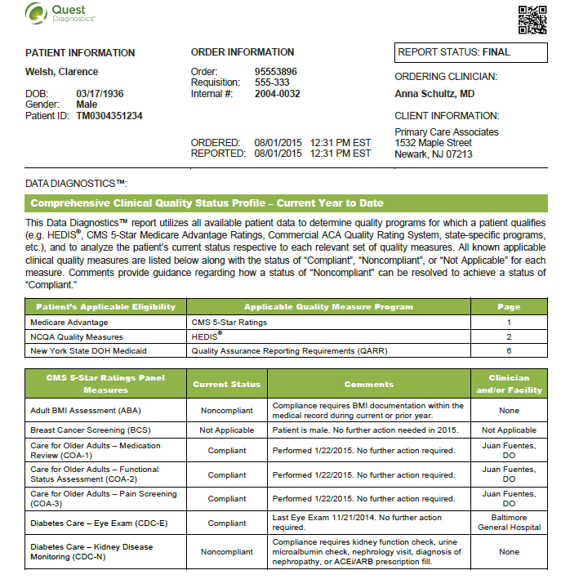
Forward looking analytics
2020 Success characteristics
Intuitive
At the point of care
Real-time
Comprehensive
Predictive
Within the workflow
Interoperable

