Slide 1
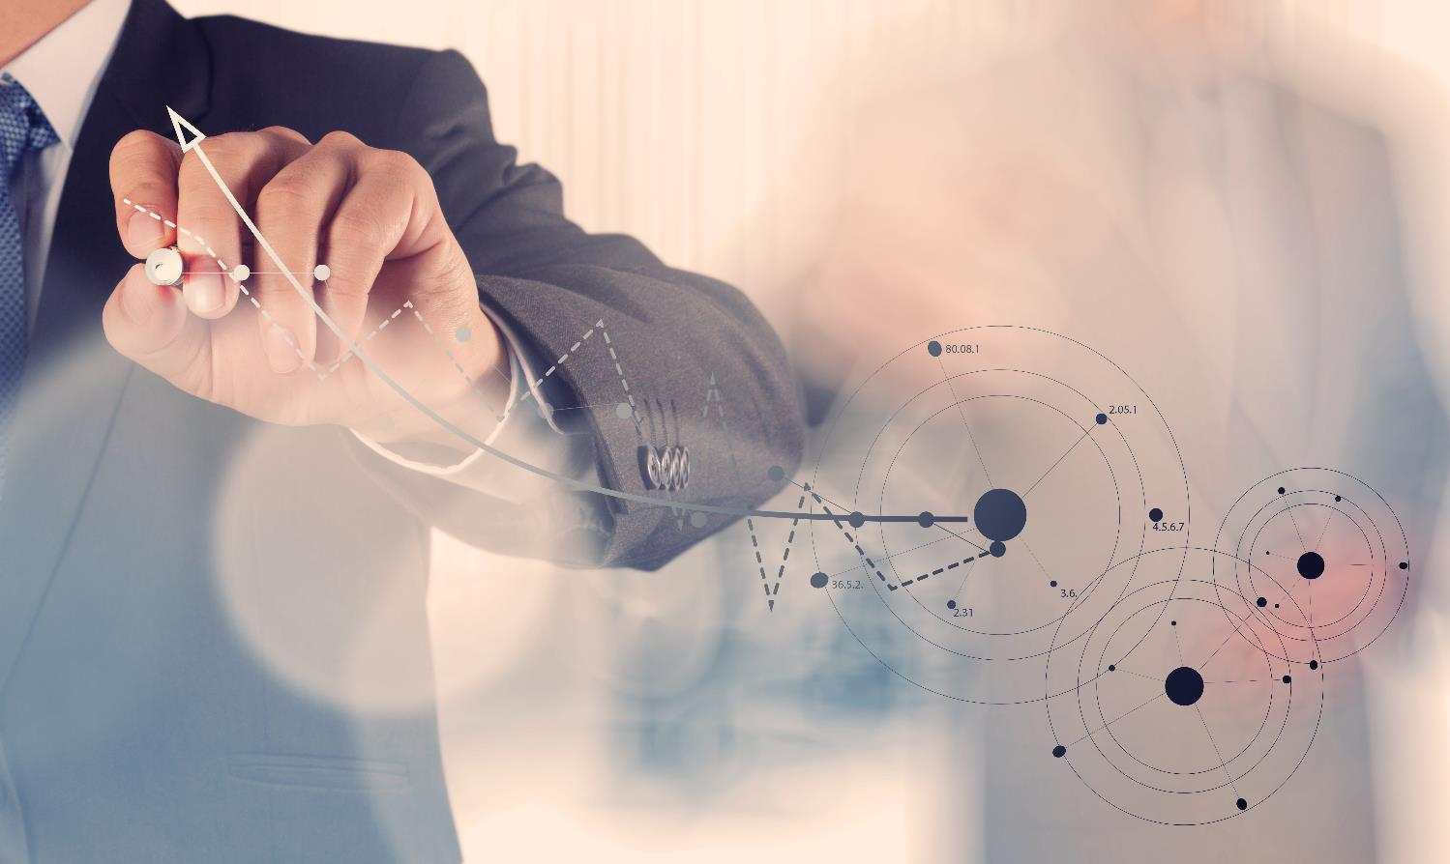
Analytics in Healthcare
Virginia Chamber of Commerce Healthcare Conference 2016
Smarter Healthcare with Analytics
Virginia Chamber of Commerce Healthcare Conference 2016
Rajeev Ronanki, Cognitive Computing and Healthcare Innovation Leader, Deloitte Consulting LLP
June 9, 2016
Rajeev Ronanki, Cognitive Computing and Healthcare Innovation Leader, Deloitte Consulting LLP
June 9, 2016
Deloitte Copyright © 2015 Deloitte LLC. All rights reserved.

Slide 2
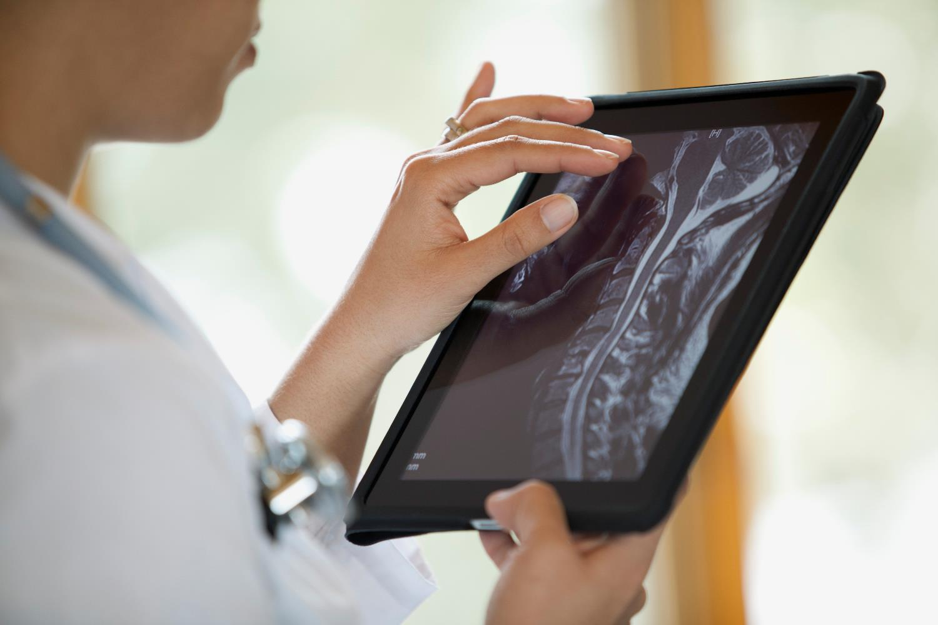
Healthcare Data is the new oil and Exponentials are the Refineries
Deloitte Copyright © 2015 Deloitte LLC. All rights reserved.

Slide 3
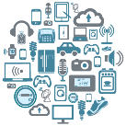
data environment is rapidly changing
Healthcare organizations are facing a deluge of rich data that is enabling them to become more efficient, operate with greater insight and effectiveness, and deliver better service
Sources of the data deluge
Mobile
EMRs
Paper / Text Documents
Social Media
Images
Videos
Sensors / Devices
40-50%
Annual growth in digital data volume*
62%
Annual growth in unstructured data*
~9X
of unstructured data vs. structured data by 2020**
Advances in computing power and techniques
Smarter Algorithms
Faster Processing Speed
Improved Visualization
Retail Consumerism
Value Based Care
Personalized Digital Health
Preventative Medicine
Drug Trials and Discovery
Advances analytical and computing techniques coupled with the explosion of data in healthcare organizations can help uncover leading clinical practices, shrink research discovery time, streamline administration, and offer new personalized engagement paradigms at an industrial scale that align people’s decisions and actions in ways that improve outcomes and add value
* HP Autonomy, Transitioning to a new era of human information, 2013
** Steve Hagan, Big data, cloud computing, spatial databases, 2012
Customer Centric
Optimal Cost Structure
Adaptive Organization
Deloitte Copyright © 2015 Deloitte LLC. All rights reserved.

Slide 4
Reimagine how data is used
Transform into an organization where decision-making is based on evidence and data driven insights
From Data to Insights to Decision-Making
Traditional Analytics Process
?
Google
Ad-hoc Data Aggregation
Query-Based Analysis
Insights Creation
Decision-Making
Insight Generation Process
Google
Continuous Sensing
Automatic Data Aggregation & Correlation
Insights Creation
Decision-Making

Slide 5
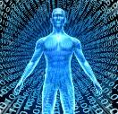
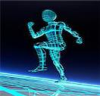
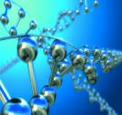
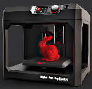
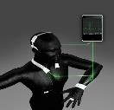
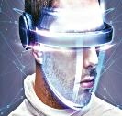
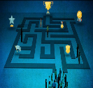
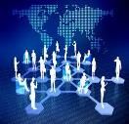
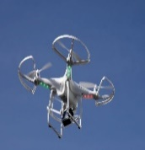
DATA and Exponential technologies are converging to transform and disrupt industries
Cognitive Computing
Robotics
Synthetic Biology
Augmenting or amplifying human cognition through advanced technologies such as artificial intelligence, machine learning, etc.
Next generation robotics and automation technologies that can work alongside humans
The ability to produce synthetic tissues and organs creates new opportunities for surgical therapy and device production
Digital Medicine
Additive Manufacturing
Ambient Computing
Personalized sensing and remote monitoring of physiological metrics leveraging new digital paradigms
3D scanning, digital design, and 3D printing digitize the creation / distribution of products
Ecosystem of “things” that can intelligently respond in real time to business needs through connectivity and sensing
Incentive Competitions
DIY & the Maker Movement
Virtual / Augmented Reality
Using a prize based competition to evoke a community to participate in solving a problem
The creativity unlocked when the public has access to the tools needed to create manufactured works themselves
Additive technologies to better equip care providers in their day-to-day tasks and improve health outcomes through differentiated experiences
Gamification
Crowdsourcing
Crowdfunding
Leveraging game mechanics to incentivize individual or group behaviors
Involve communities to collaborate in solving complex, non-linear problems, calling upon diverse skillsets
Leveraging the public to fund the creation of a product or company
Blockchain
Commercial UAVs (Drones)
Distributed ledger technology that offers a new way of recording transactions or any digital interactions
Aerial robots to transform logistics relating to the delivery of goods and services

Slide 6
Linear vs. Exponential
30 Linear Steps
vs.
30 Exponential Steps
Walking across the room
Walking 26 times around the planet

Slide 7
Transform the entire value chain with data and Exponentials
Exponential technologies are radically transforming all aspects the health care value chain
1
2
3
4
5
6
The future of care delivery / surgery
The future of the patient
The future of healthcare operations
The future of research
The future of precision medicine
The future of medical education
How might artificial intelligence, machine learning, and big data empower physicians, scientist and patients alike with the latest, most accurate clinical understanding in real time?
How can wearables, networks, sensors and virtual reality foster patient engagement and care coordination that transforms disease management?
How will additive artificial intelligence transform operations to optimize their supply chains, utilize just-in-time manufacturing, and increasingly automate their workforces to maximize efficiency?
How will natural language understanding transform the focus of research from discrete academic facilities to a global network of connected & collaborating scientists?
How will genomics and precision medicine provide healthcare professionals with an expanded toolkit to interact directly with DNA and enable proactive management of risks and more precise treatments?
How can virtual/augmented reality revolutionize medical training and accelerate knowledge transfer?

Slide 8
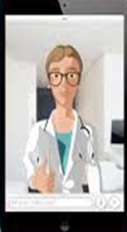
The future of care delivery
Transforming the who, what, and where of care delivery
Sample Use Cases
When Care is Delivered
Where Care is Delivered
Who Care is Delivered by
Retina Selfie – Retina self-imaging allows patients to monitor for diseases such as multiple sclerosis and detect early warning signs
Healogram – Mobile platform that helps providers remotely monitor patients post-surgical procedure
iDAvatars – Virtual avatar, Sophie, uses artificial intelligence and natural language processing to remotely monitor patients
Drivers of Disruption
Sample Market Signals
Artificial Intelligence
Robotics
Augmented Reality
Personalized Medicine
Additive Manufacturing
The future of care delivery / surgery
The future of the patient
The future of healthcare operations
The future of research
The future of precision medicine
The future of medical education

Slide 9
The future of surgery
Transforming what surgeons see, know, and do
Sample Use Cases
What We See
What We Know
What We Do
SNAP Surgical Theater – augments surgeons’ reality with CT/MRI scans to see behind arteries and other critical structures
Oculus Rift – improves training by allowing medical students to watch surgeries from the lead surgeon’s point of view
BoneWelding – stronger bonds and improved osseo-integration enable new implant designs & surgical methods
Drivers of Disruption
Sample Market Signals
Artificial Intelligence
Augmented Reality
Personalized Medicine
Additive Manufacturing
Networks & Sensors
Nanotechnology
Robotics
The future of care delivery / surgery
The future of the patient
The future of healthcare operations
The future of research
The future of precision medicine
The future of medical education

Slide 10
The future of the patient
Transitioning from a passive role to an active role in health
Sample Use Cases
Tools for Self-Service
New Ways to Engage
The Quantified Self
Tyto Care – handheld device that patients can use to self-examine their mouth, throat, eyes, heart, lungs, skin, and temperature
Deloitte Cognitive Engagement – designed to boost patient involvement in care and expand the type of alerts and interactivity offered online
Ginger.io – aggregates cellphone data to monitor patient’ mental health and alert caregivers when symptoms are problematic
Drivers of Disruption
Sample Market Signals
Networks & Sensors
Wearables
Artificial Intelligence
Digital Medicine
Robotics
The future of care delivery / surgery
The future of the patient
The future of healthcare operations
The future of research
The future of precision medicine
The future of medical education

Slide 11
The future of healthcare operations
Automating labor and JIT manufacturing
Sample Use Cases
Efficient Administration
Improved Productivity
Workforce Augmentation
Care at Hand – Helps to prevent readmissions by deploying nursing staff skills to maximum efficiency
Aethon TUG Robots – Smart, autonomous robots substitute for the labor needed to haul and transport materials & clinical supplies
Evena – Technician glasses provide high- definition, real-time images of vascular anatomy to enable fast, precise IV access
Drivers of Disruption
Sample Market Signals
Additive Manufacturing
Robotics
Artificial Intelligence
Automation
Nanotechnology
The future of care delivery / surgery
The future of the patient
The future of healthcare operations
The future of research
The future of precision medicine
The future of medical education

Slide 12
The future of research
Changing the how and who perform research
Sample Use Cases
Scientific Breakthroughs
New Collaboration Models
Operational Efficiency
Illumina – reached milestone of making it feasible to read someone’s genome for $1000, down from $95.3 Million in 2001
Foldit – predicts the structure of a protein by taking advantage of humans' puzzle-solving intuitions through an online game
IBM and Mayo Clinic – using artificial intelligence to more accurately match patients with appropriate clinical trials
Drivers of Disruption
Sample Market Signals
Synthetic Biology
Additive Manufacturing
Genomics
Personalized Medicine
Nanotechnology
The future of care delivery / surgery
The future of the patient
The future of healthcare operations
The future of research
The future of precision medicine
The future of medical education

Slide 13
The future of precision medicine
Enabling proactive and precise treatments
Sample Use Cases
Preventative Measures
New Research / Treatment Methods
Increased Precision
Human Longevity Inc. – building the world’s most comprehensive database on human genotypes
LiverChip – Dynamic 3-D cell culture platform can exactly mimic the architecture and physiology of the human liver
Wyss Institute – Harvard scientists built a nano-robot from designer DNA to deliver drug dosages to specific cell types
Drivers of Disruption
Sample Market Signals
Genomics
Personalized Medicine
Nanotechnology
The future of care delivery / surgery
The future of the patient
The future of healthcare operations
The future of research
The future of precision medicine
The future of medical education

Slide 14
The future of medical education
Revolutionizing medical training
Sample Use Cases
Expanded Perspective
New Learning Forums
Increased Collaboration
Dassault Systemes – Augmented reality allows for enhanced visualizations and simulations
Pop Up Labs –creates in-house maker spaces to enable/accelerate medical professionals’ best practices and creation
CrowdMed – Medical professionals across the globe collaborate on cases and learn of new treatment methods
Drivers of Disruption
Sample Market Signals
Virtual / Augmented Reality
Additive Manufacturing
Maker Movement
Crowdsourcing
The future of care delivery / surgery
The future of the patient
The future of healthcare operations
The future of research
The future of precision medicine
The future of medical education

Slide 15
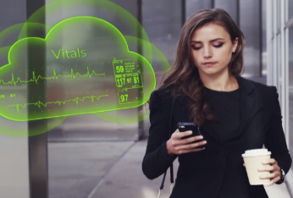
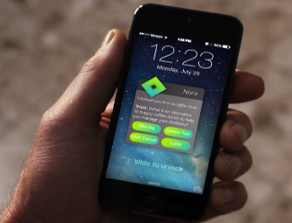
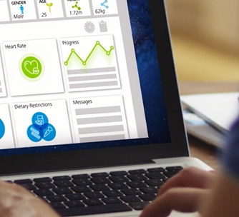
Use insights from analytics to drive action
Meet Nora, who takes the complexity out of managing health and achieving goals
1.
Makes every day/routine tasks easier: Pay bills, find a doctor nearby/schedule appointment, understand health care benefits, refill prescription, monitor health in real time and notify family members or medical personnel if desired
2.
Manages chronic diseases: Monitor blood sugar, track calorie intake and activity, order supplies, submit claims + routine needs above
3.
Provides care anywhere: Understand care plans and discharge notes, care delivery at home, integrate with IoT
4.
Improves health IQ: Provide personalized, context aware and relevant health/fitness tips, recommendations and insights; Proactively engages with user to achieve health goals
5.
Plays the role of information agent: Piece together multiple aspects of complicated questions and provide a personalized package of insights, advice, and data based on individual cases/circumstances
Intelligent assistants: Nora
Pwd: nora
Deloitte Copyright © 2015 Deloitte LLC. All rights reserved.

